Slide 1
AI Capstone Project Kickoff : DealDetective
Presented By
Binish Paudel Rabin Giri Vraj Gandhi Sukhmandeep singh

Slide 2
Objective
Build an AI-powered price comparison application to automate the process of finding the best product prices across multiple online retailers.
This application will:
✔ Use AI to recognize products from images.
✔ Automate price fetching via web scraping.
✔ Compare and track prices in real-time to help users make informed purchasing decisions.
The project will demonstrate technical proficiency by integrating AI, cloud computing, and automation, aligning with business outcomes and delivering measurable impact. 🚀

Slide 3
Scope
Focus on automating price comparison using AI-based object recognition and web scraping.
Deliver a fully cloud-hosted, real-time solution that provides accurate price insights.
Ensure a practical, deployable system that integrates with live e-commerce data.

Slide 4
Features
Basic
Image Upload and Storage
Basic Object Recognition
Price Scraping Advance ( 3 selected )
Real-Time Price Tracking
Customizable Search Parameters
User Profile and History

Slide 5
Impact
Business Impact:
Helps consumers save time and money by automatically fetching and comparing product prices.
Enhances online shopping experiences through real-time updates and personalized tracking.
Educational Impact:
Demonstrates end-to-end AI application development, from image recognition to web scraping and cloud hosting.
Combines multiple disciplines (AI, automation, data engineering) into a real-world use case.

Slide 6
Project Plan
1️⃣ Discovery & Planning
Define the business use case: Automating price comparison through AI and web scraping.
Align objectives with real-world shopping needs and AI-powered automation.
Assess data readiness (e-commerce product images, pricing data sources).
2️⃣ Development
Train an AI model for object recognition (using pre-trained models).
Implement web scraping & price tracking modules.
Build the application interface (frontend + backend integration).

Slide 7
Project Plan cont.
3️⃣ Testing & Deployment
Validate AI model accuracy and price fetching reliability.
Ensure usability and performance optimization.
Deploy the final solution on cloud platforms (AWS/GCP/Azure).
Key Deliverables:
✅ Prototype in [Week 9] – A working demo with basic features (image upload, object recognition, price comparison).
✅ Fully Functional Capstone Project by [Week 16] – A production-ready web app with cloud hosting, AI integration, and real-time price tracking.

Slide 8
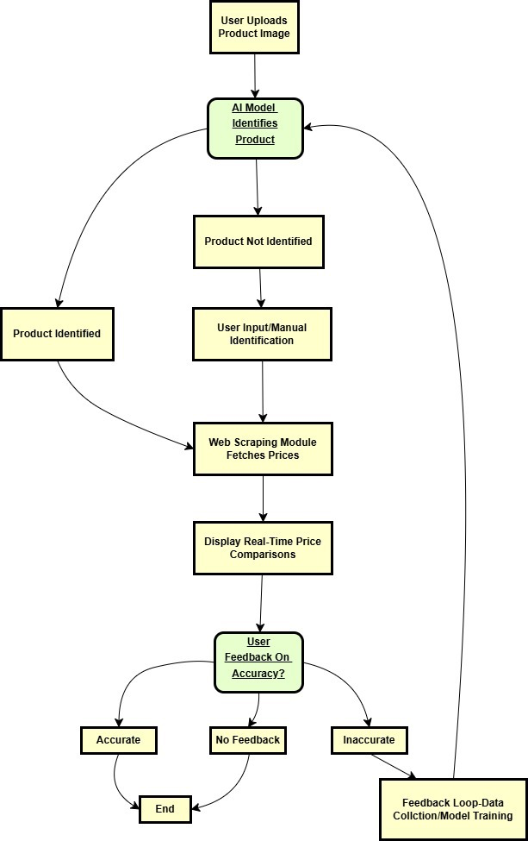
Application Flow

